Slide 1
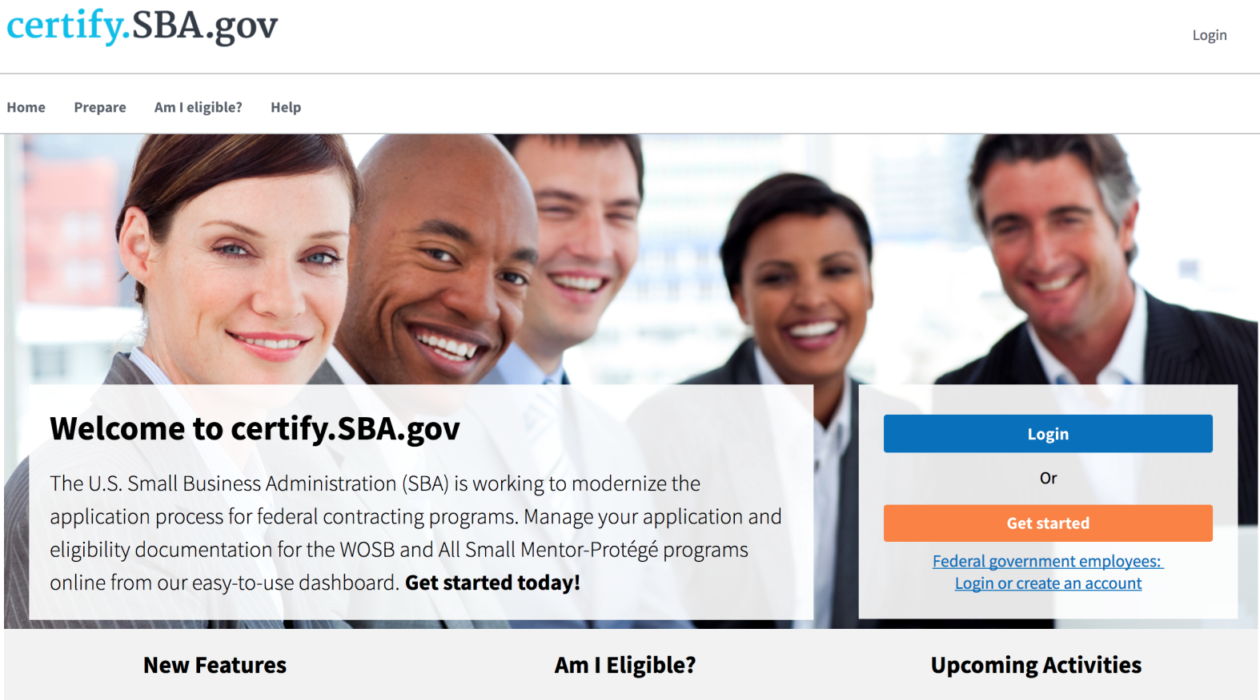
Overview of the 8(a) Program in Certify.SBA.gov for Firms
Fall 2017

Slide 2
The purpose of this PowerPoint is to inform Firms how they will submit their 8(a) application starting November 15, 2017 on Certify.SBA.Gov.

Slide 3
Our Mission
To create a one-stop shop for small business to apply for SBA Small Business Programs.
To help SBA build an effective, efficient, and accountable case management system.

Slide 4
Before Certify Paper Applications & Burdensome Processes
Small businesses downloaded forms, printed all required supporting documents, and mailed reams of paper to SBA simply to apply to the 8(a) program.
SBA mailed files between district offices to share information required to manage small business accounts. This adds up to hundreds of thousands of dollars in costs annually.

Slide 5
After Certify
Re-use Docs
Online Questionnaires
Eliminate redundancy by storing documents in one location and re-using them for future needs.
Firms now have the ability to complete online questionnaires rather than fill out lengthy and sometimes repetitive forms.
Transparency – Status Updates
Direct Messaging
Firms will be able to check their application dashboard for the most up-to-date information about their applications. This minimizes the need to call or email the SBA for information about where their application is in the process.
Firms will be able to respond to SBA requests via an internal messaging system. This ensures your PII is safe and responses are not sent to spam or junk filters.

Slide 6
Firm View of Certify Features

Slide 7
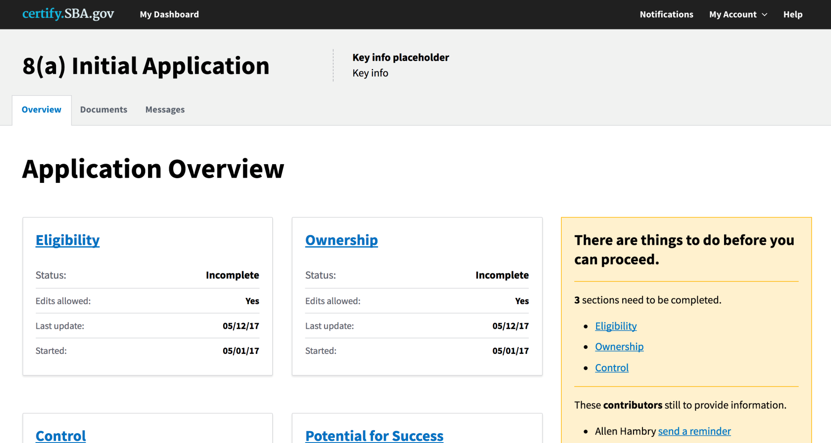
Firm View of Certify Features
Firms will be able to see all aspects of their application on one page:
Application Sections
Document Library Tab
Messages to Replace Email with SBA
Notifications of Tasks to Complete
Additional Contributors can Input Data

Slide 8
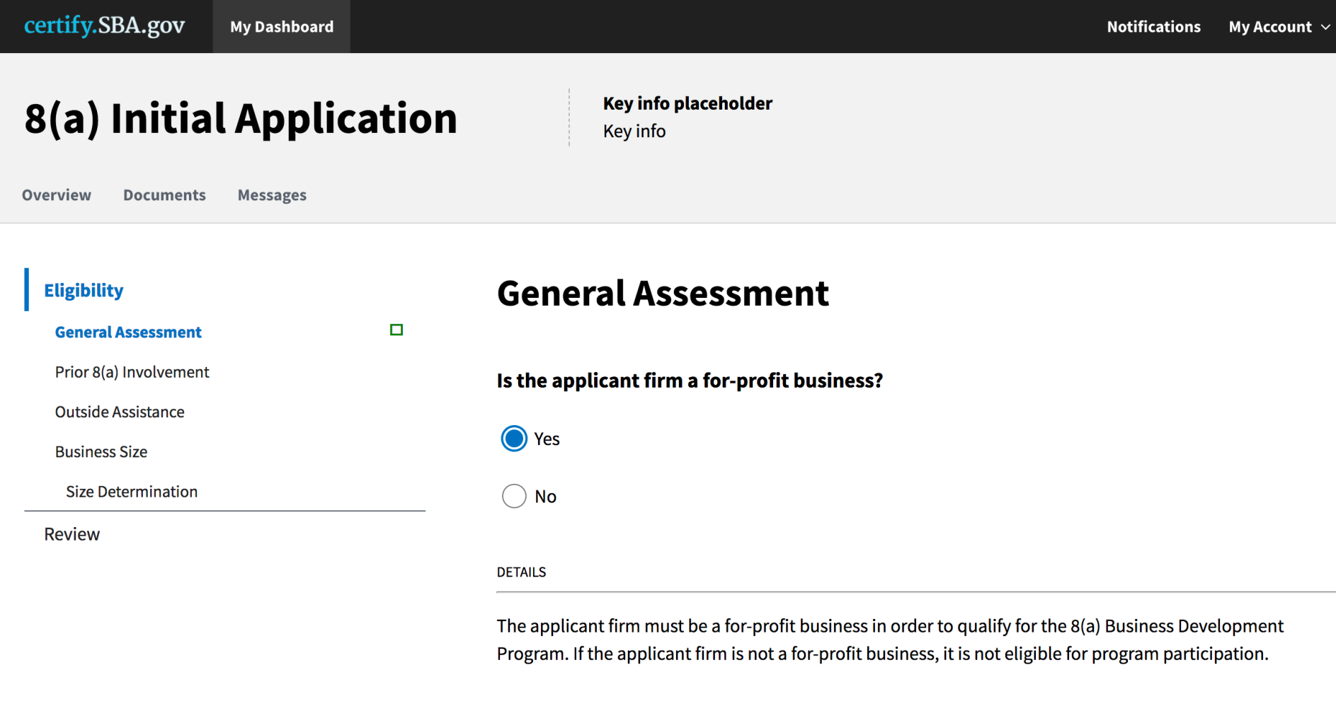
Meet the New Online Questionnaire
Most forms have been converted into online questionnaires to make it easier for firms to answer questions relevant to them.
Firms will answer each questionnaire in order until they’re done with all five sections.

Slide 9
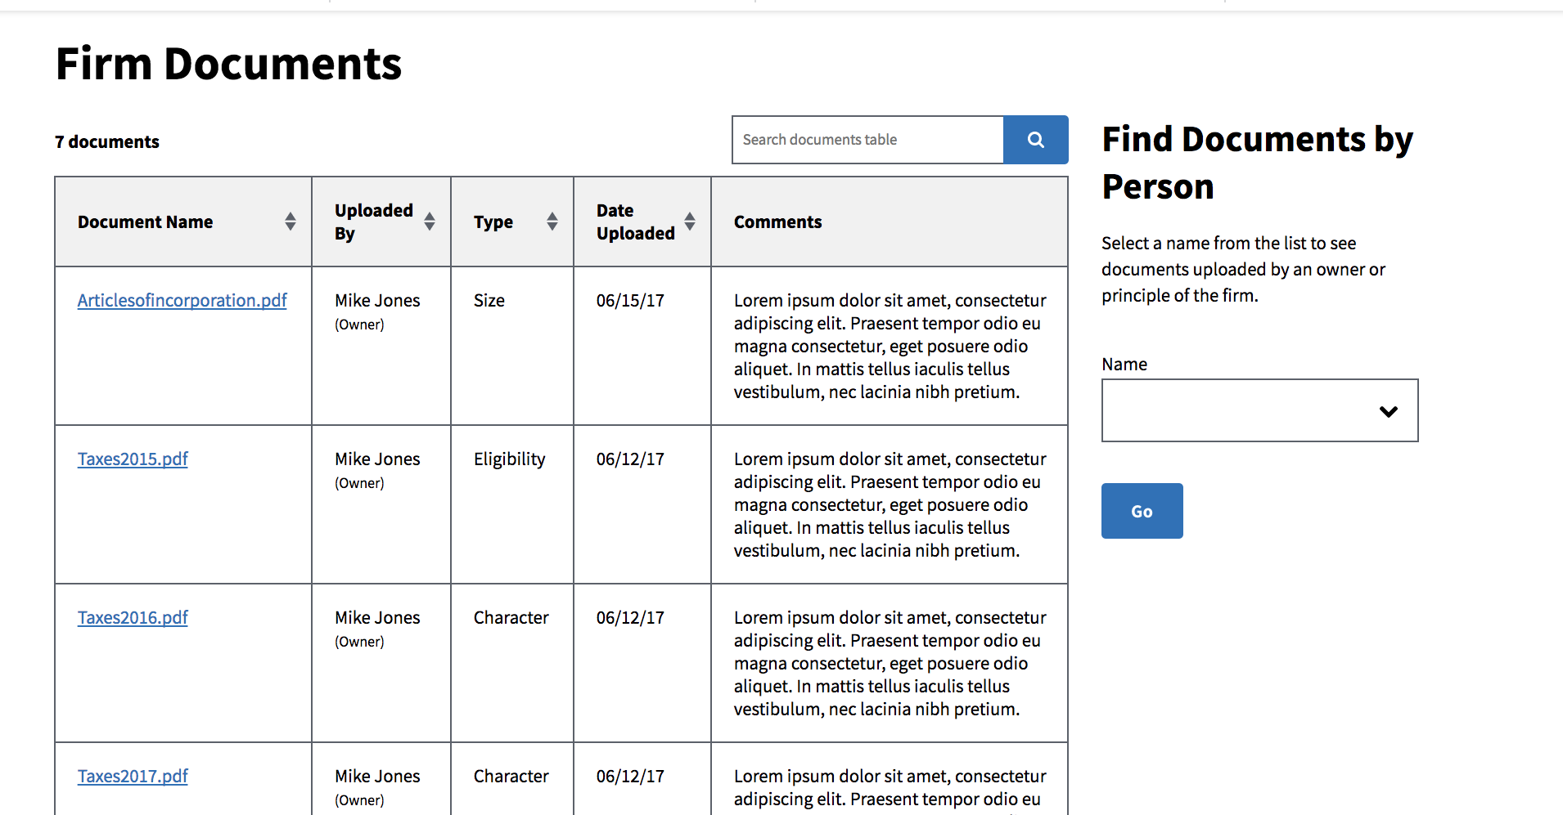
View the Document Library

Slide 10
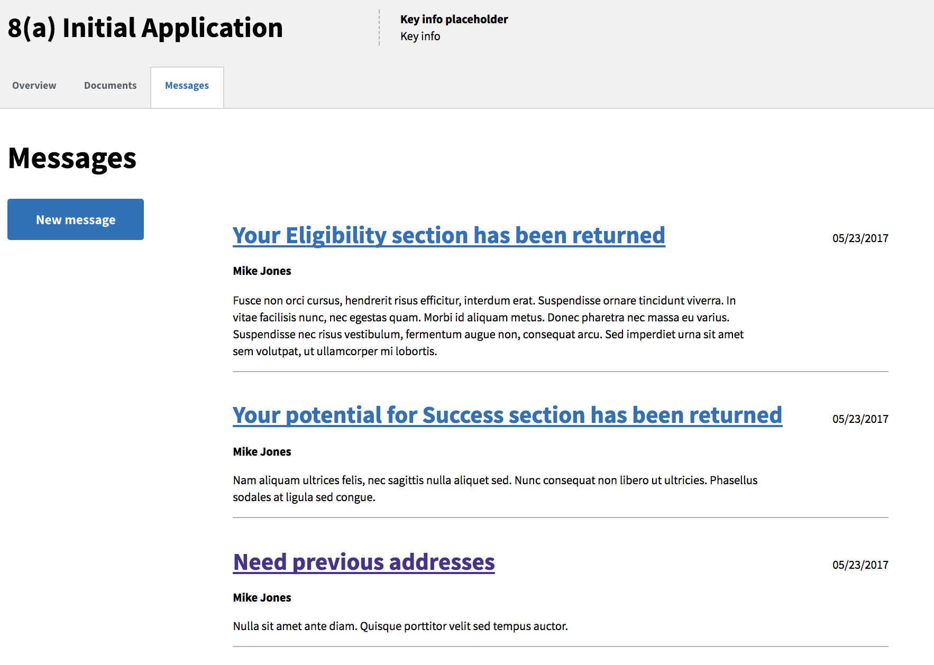
Messaging Replaces Email

Slide 11
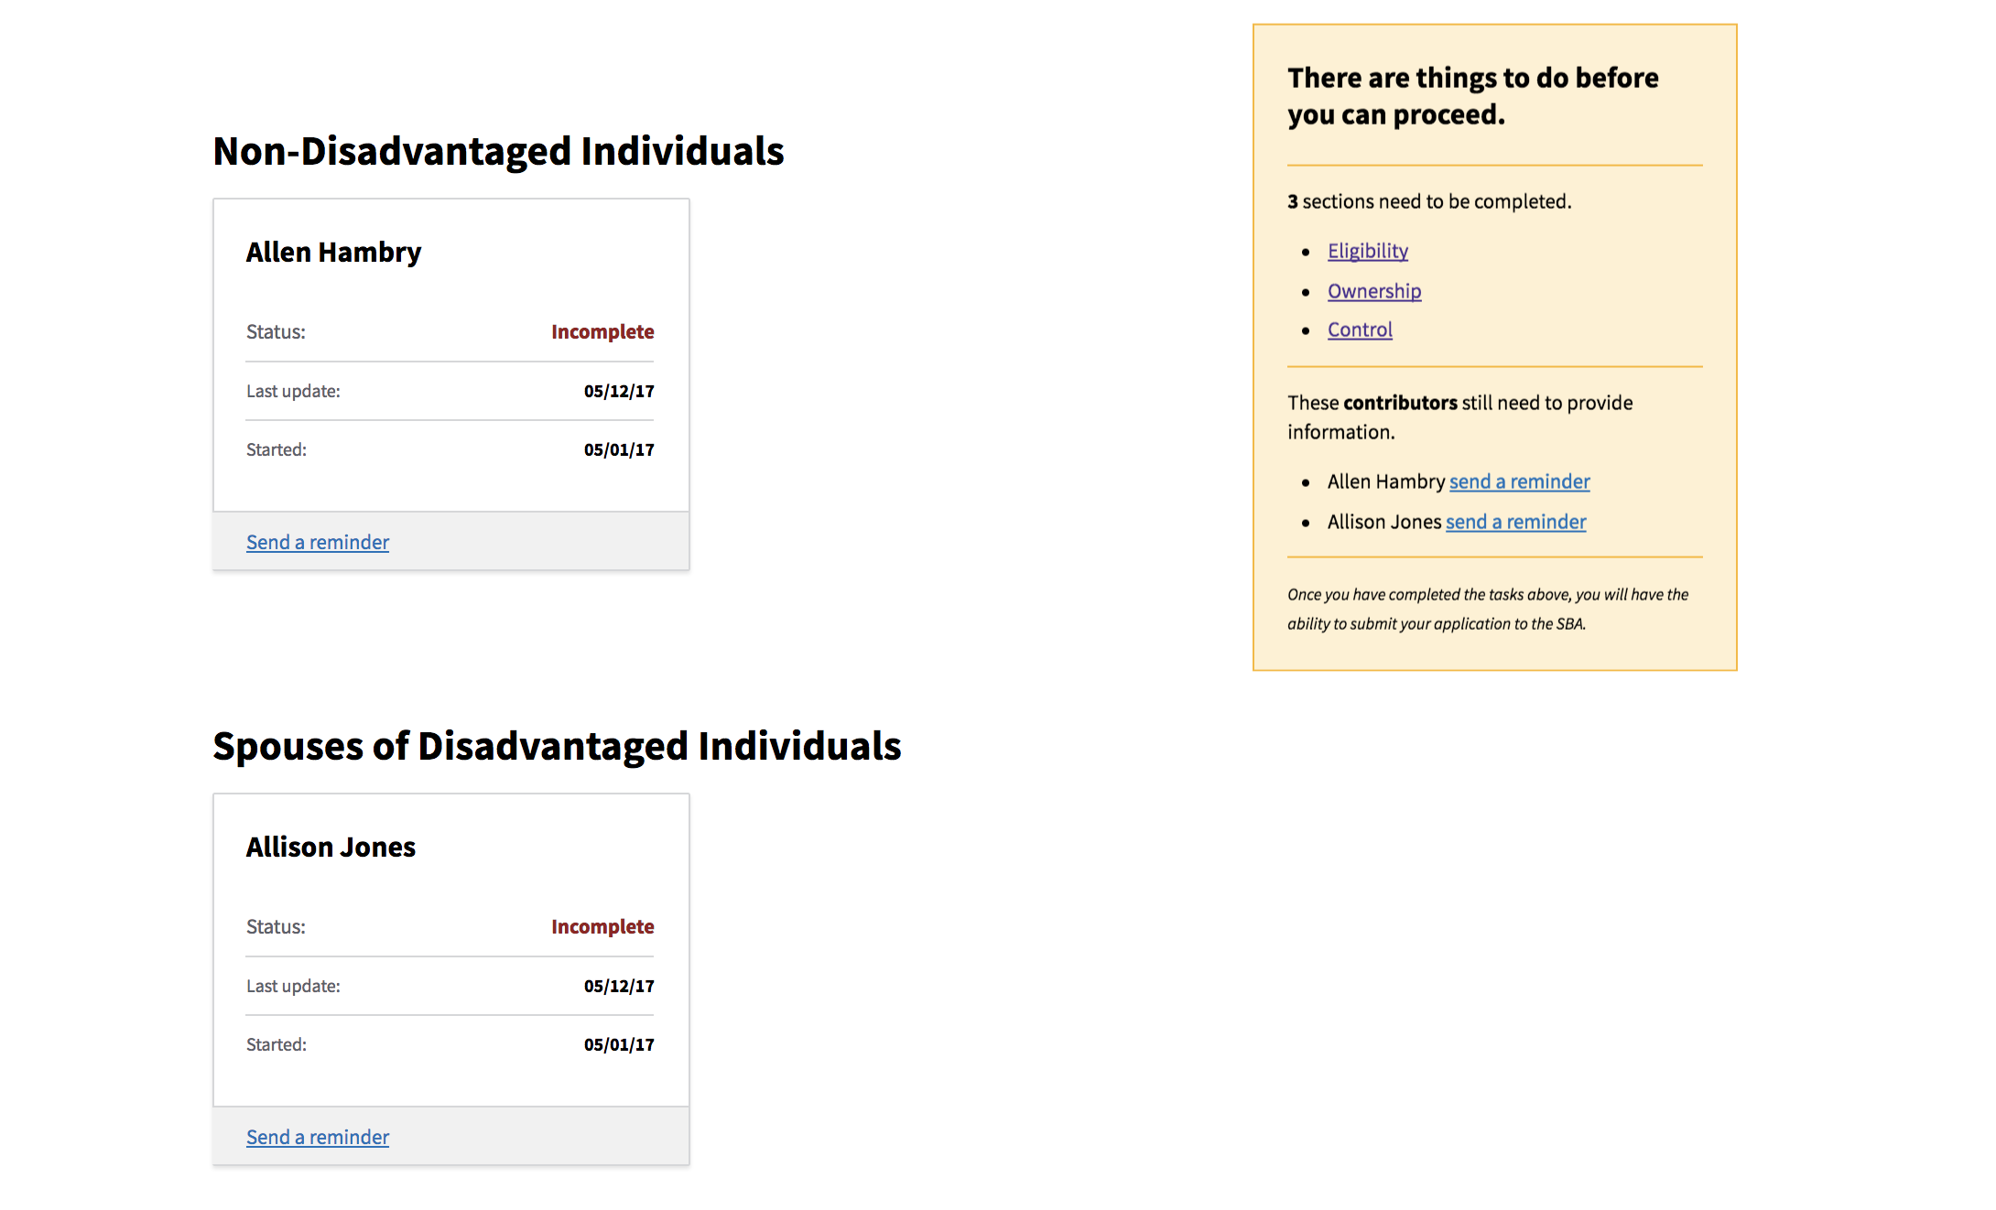
Firms can now share access with all contributors.
The applicant will receive notifications regarding which sections, including other contributors, are still outstanding.

Slide 12
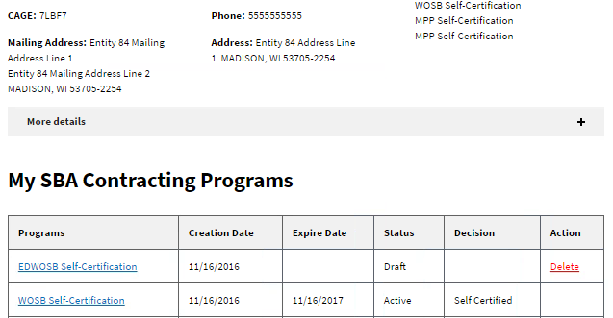
Firm Dashboard
Firm’s Dashboard of all Certifications:
The status of program applications and renewal deadlines
View all firm’s SBA certifications, not just 8(a).

Slide 13
Firms learn about GCBD programs and apply online.

Slide 14
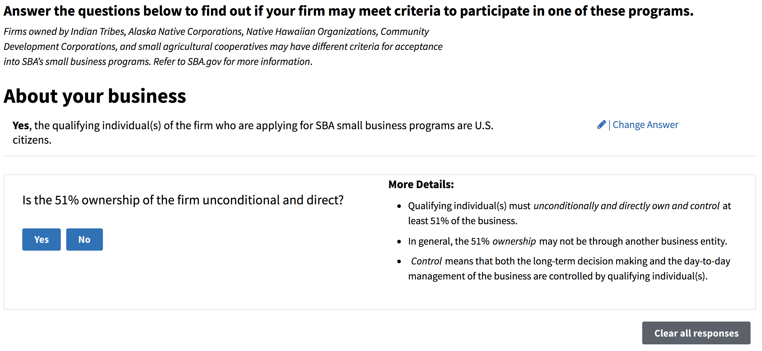
Am I Eligible
“As a small business owner, I want an easy way to determine which Small Business Programs I may be eligible for, so that I can focus my time appropriately.”

Slide 15
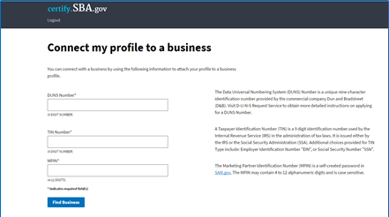
The 8(a) Application Process in Mid-November
Before you sign up for Certify:
Step 1: Obtain a DUNS Number
Step 2: Register in SAM.gov
Step 3: Apply on Certify.SBA.gov

Slide 16
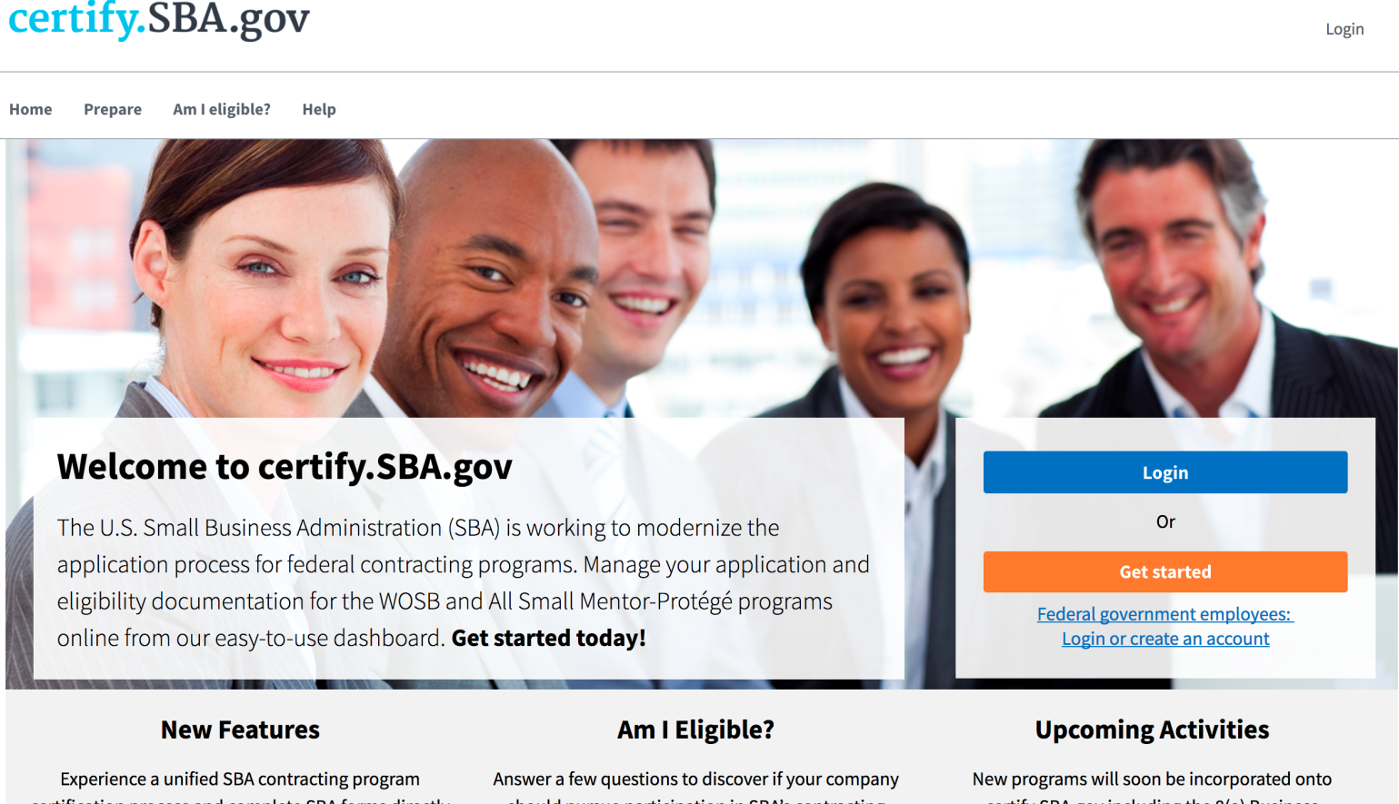
The 8(a) Application Process in Mid-November
Visit Certify
Firms should logon to Certify.SBA.gov and press the orange “Get started” button.
Register on Certify
Firms must complete the registration process, and link their account to their SAM profile through their DUNS number, to gain entrance into the Certify platform.

Slide 17
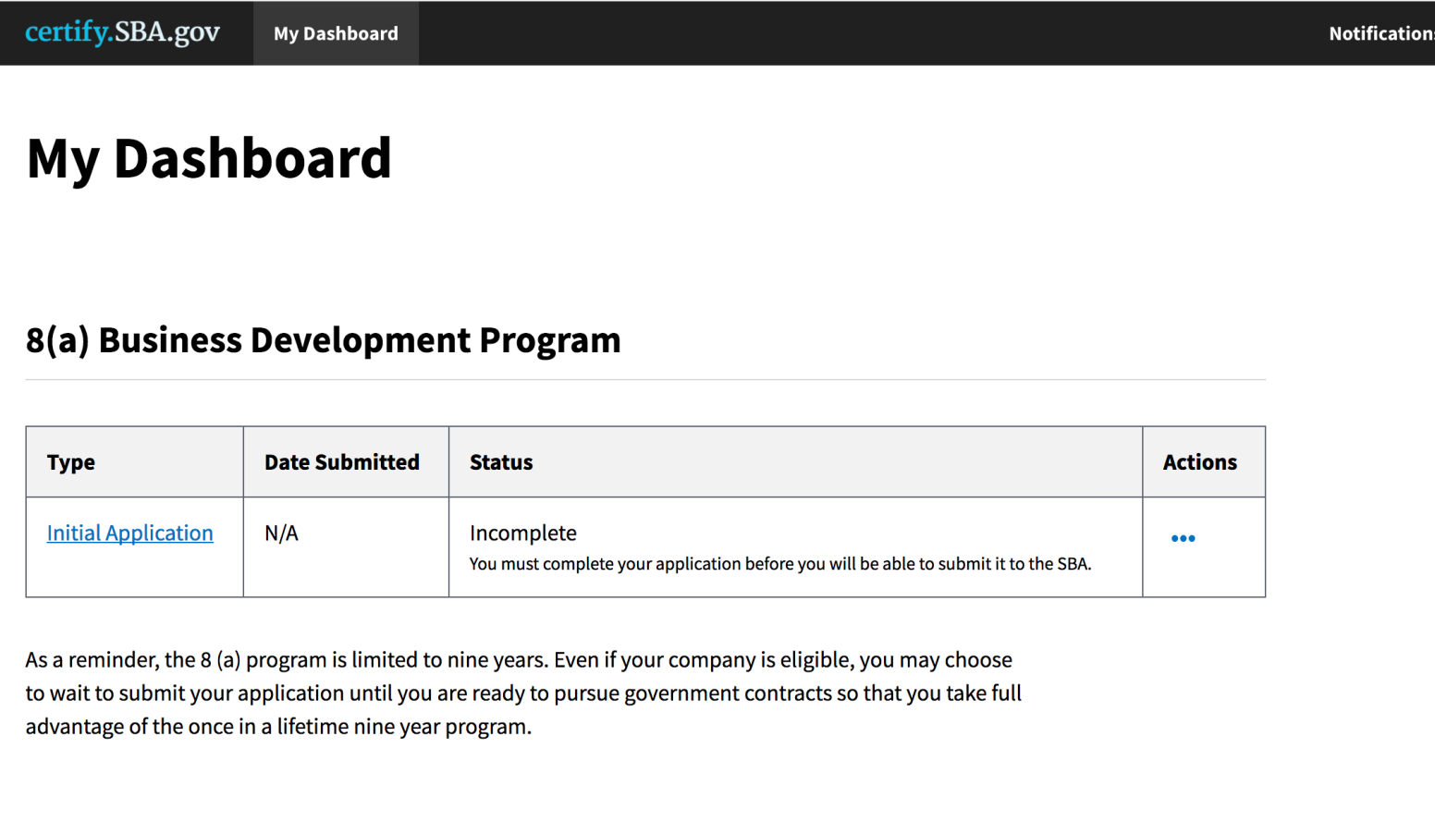
The 8(a) Application Process in Mid-November
Preview the Dashboard
Firms will have a custom dashboard that provides one-click access to their initial application.
Start the Application
Click on the blue “Initial Application” link to be taken to the full application. Alternatively, Firms can click the three blue dots to “View application” or “Delete application.”

Slide 18
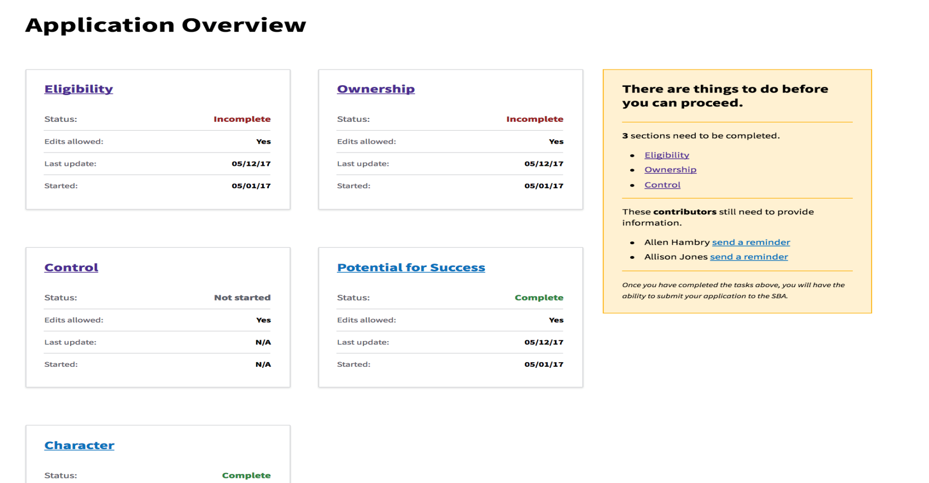
The 8(a) Application Process in Mid-November
Complete Core Sections
Previous SBA forms have been re-created as online questionnaires. Firms will be walked through how to complete all five sections.
Contributors Add Details
In addition to the five sections, all relevant Disadvantaged Individuals; as well as Non-Disadvantaged Individuals and Spouses of Disadvantaged Individuals will directly input their data.
Submit Application to SBA
Once a firm submits an application, the applicant should watch for emails from Certify asking for additional details.

Slide 19
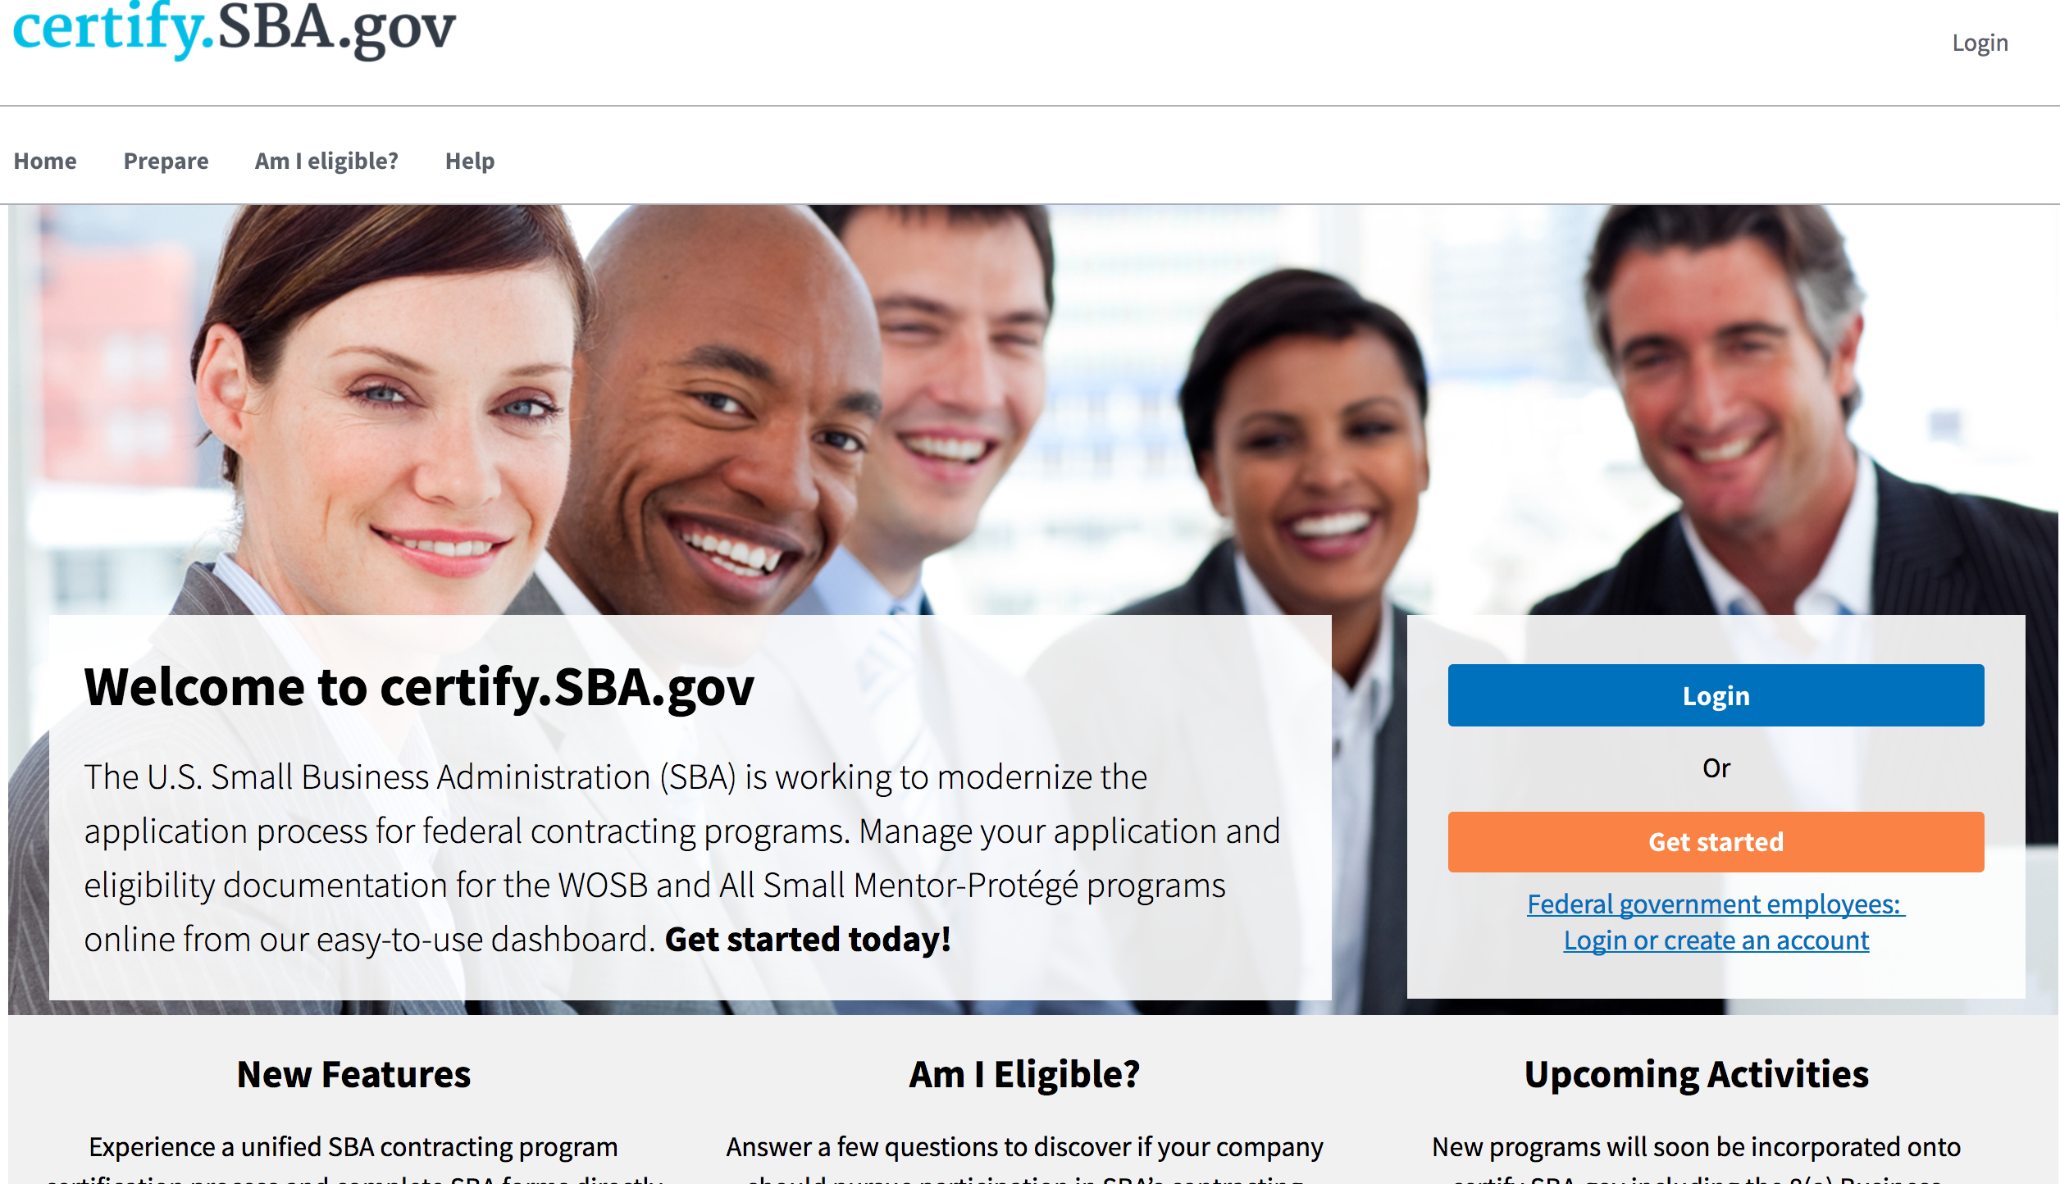
When Firms are ready to continue work on their application, log back onto certify.SBA.gov and click the blue “Login” button or the “Login” link in the top right corner.

Slide 20
By The Numbers

Slide 21
15
Number of days for
Firm 8(a) application screening

Slide 22
90
Average number of days to process
Firm 8(a) applications

Slide 23
45
Number of days for
Firms to appeal their 8(a) application results

Slide 24
Dates and Deadlines

Slide 25
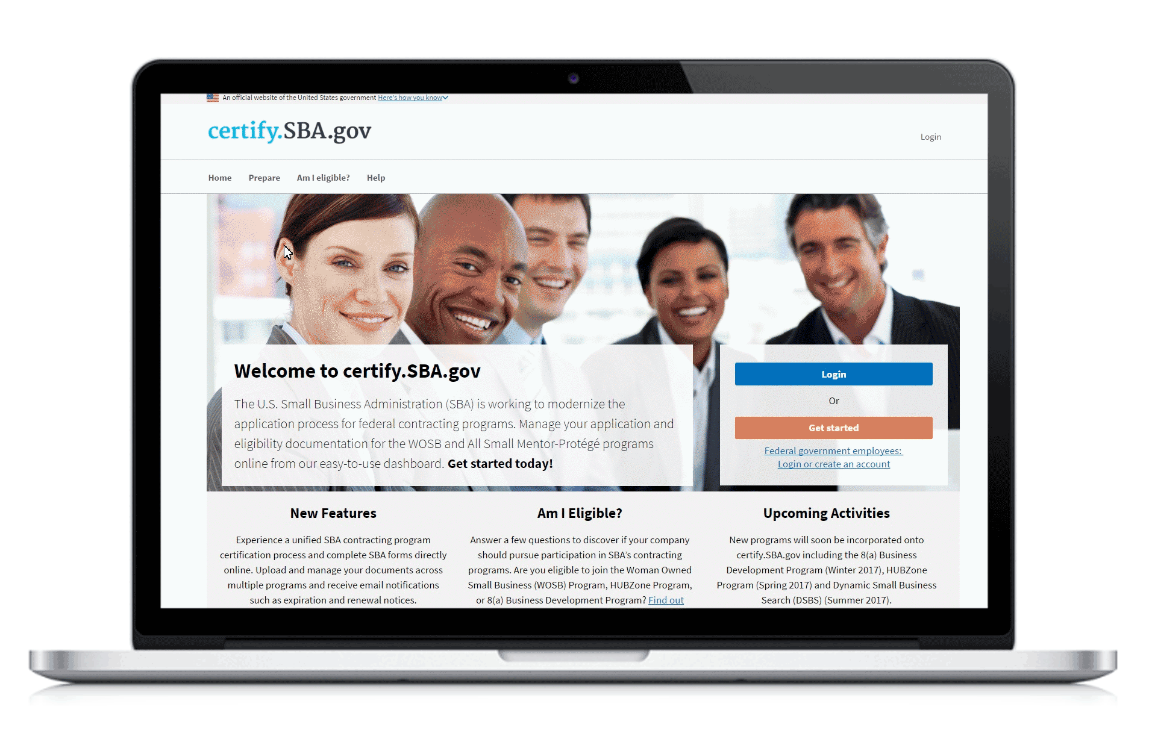
When Does Certify Go Live?
November 15, 2017:
8(a) Initial Application
January 2018:
8(a) Annual Review

Slide 26
Firm Application Dates and Deadlines
The Following Dates Are Important To Remember:
October 1, 2017 - October 15, 2017: 8(a) Applications in Process Must Be Completed, Otherwise They Must Wait to Re-Apply in Certify
October 1, 2017 – November 14, 2017: New 8(a) Applications Can’t be Started in Certify as new Firms Won’t Have Access to GLS and BDMIS

Slide 27
Questions & Feedback
?
Do you have any
questions?
Send us your feedback:
https://certify.ideas.aha.io/ideas

