Slide 1
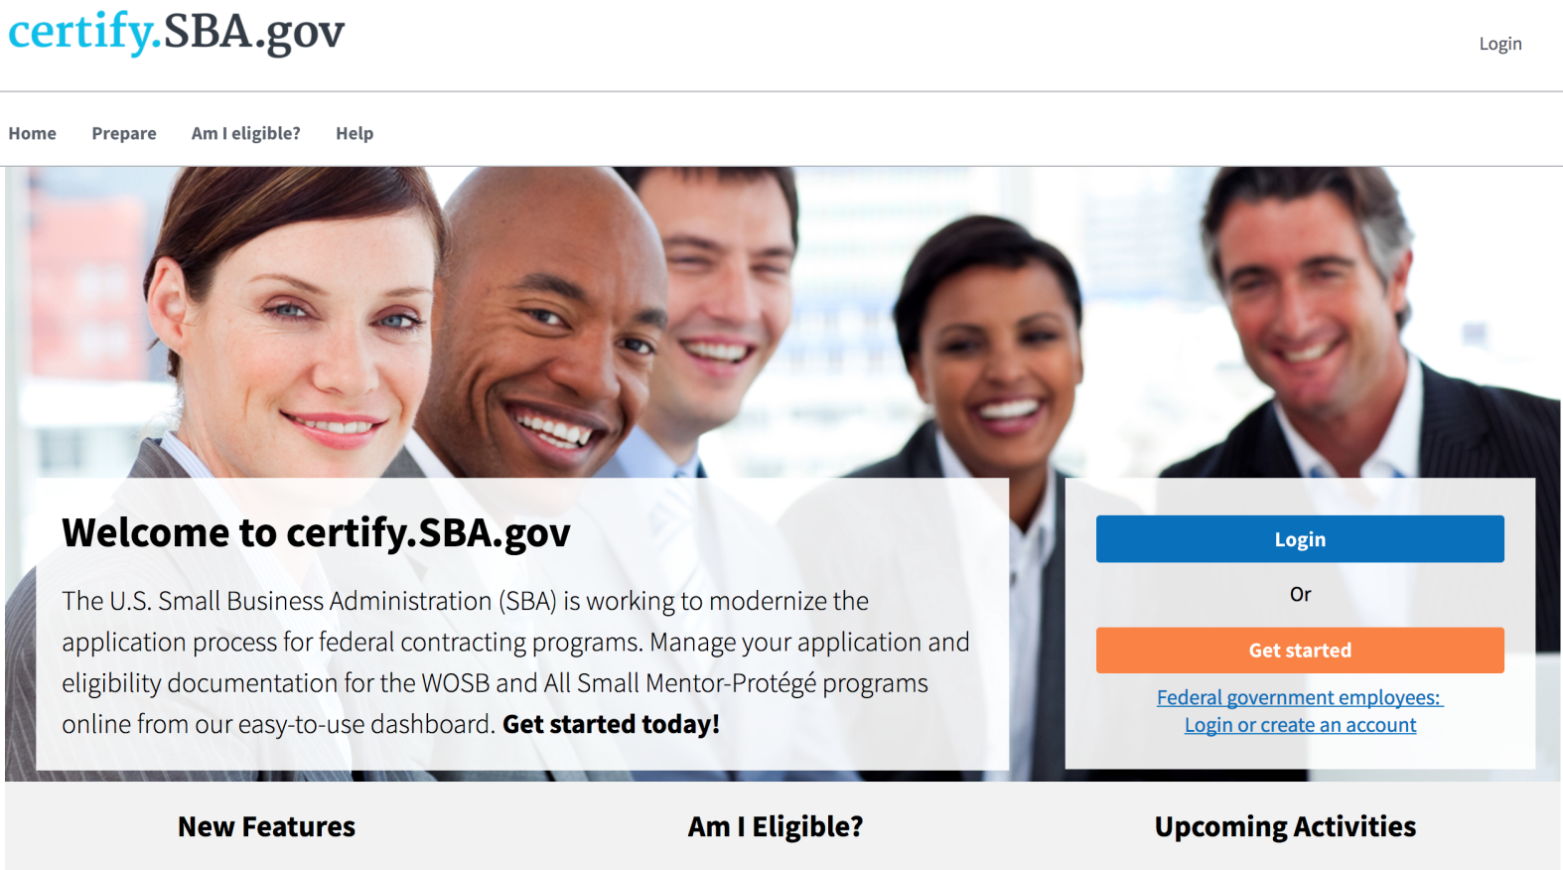
Submitting 8(a) Annual Reviews in certify.SBA.gov
Presentation Created March 2018

Slide 2
Firms can Submit Annual Reviews
22
March
Firms can begin submitting Annual Reviews in Certify
Firms must have Certify accounts and Sam.gov profiles
Firms with 3/22 anniversary dates must submit in Certify

Slide 3
All Upcoming Dates
March 21
Firms need to create accounts on certify.SBA.gov and make sure their SAM.gov information is up to date.
March 22
Firms can submit their Annual Reviews in Certify. BOS can screen cases for completeness and send letters of deficiency.

Slide 4
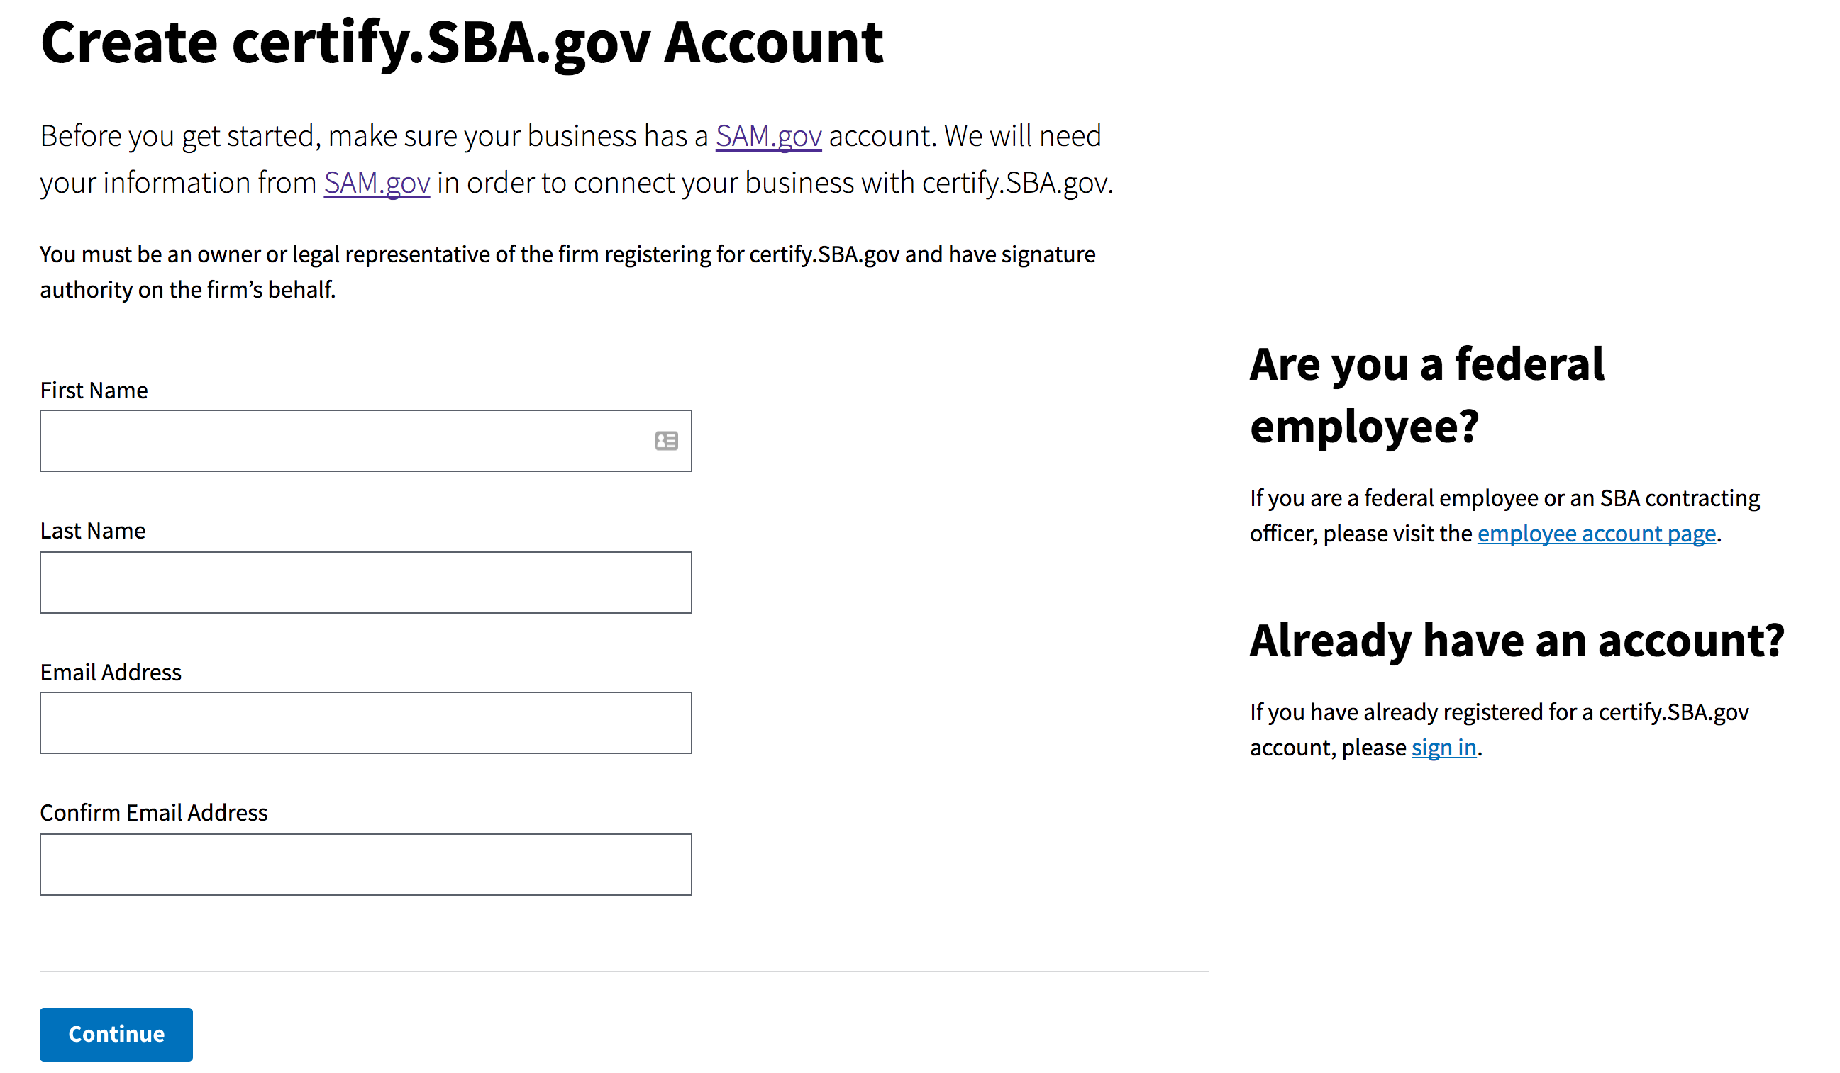
Reminder!
Firms will not be able to move forward on certify.SBA.gov without a SAM.gov account.

Slide 5
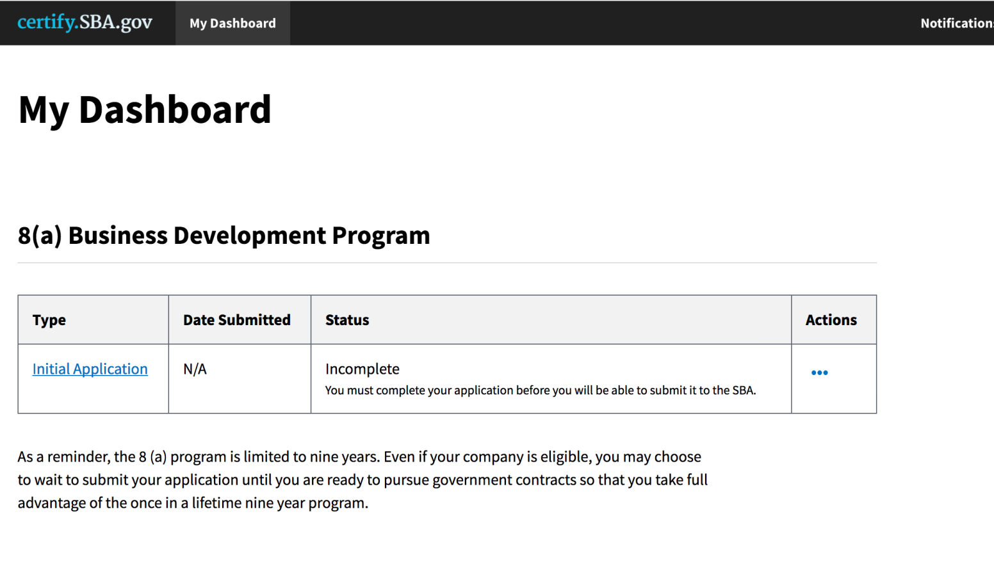
Finding your Annual Review in Certify
Click from dashboard:
For firms who have Certify accounts, Certify will send first notice 30 days before anniversary date and second notice on the anniversary date. The annual review is due 30 days after the anniversary date.
If firm cannot find the annual review, they can contact the help desk (help@certify.sba.gov)
If firm has an annual review but already submitted it in BDMIS, they can contact the help desk (help@certify.sba.gov)
Annual Review

Slide 6
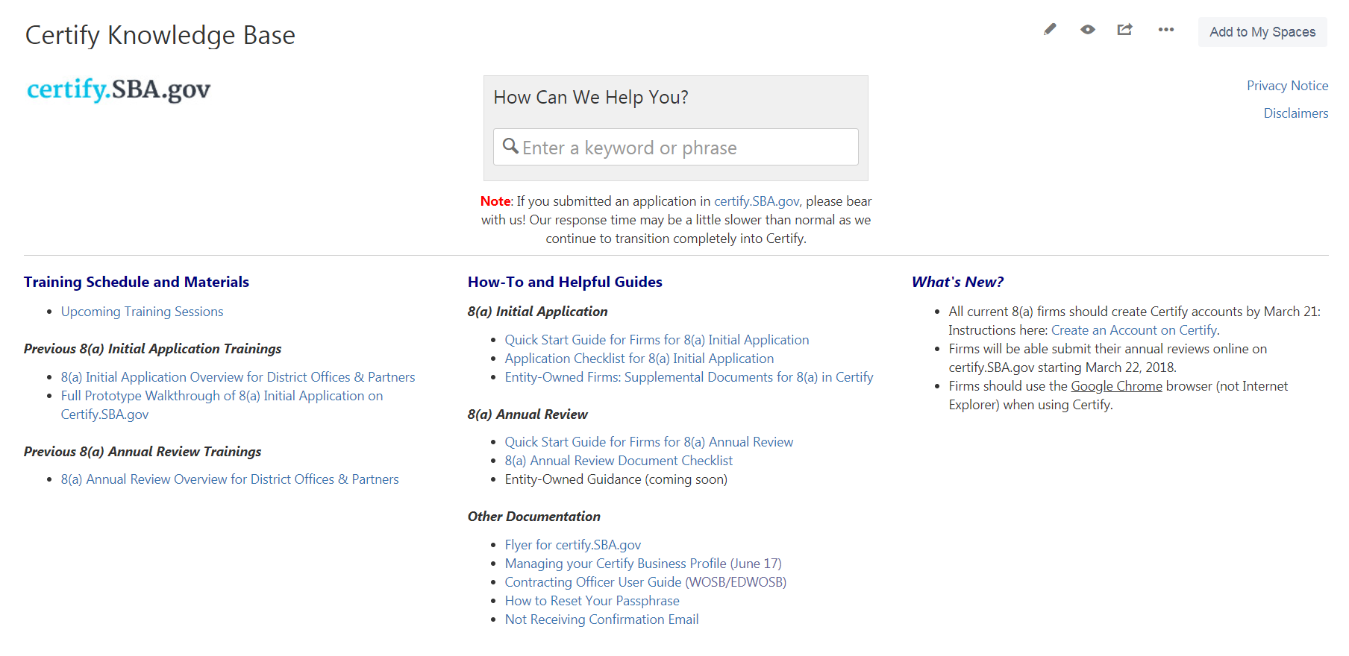
Prepare
Document Checklist
Quick Start Guide
Entity-Owned Firm Workaround

Slide 7
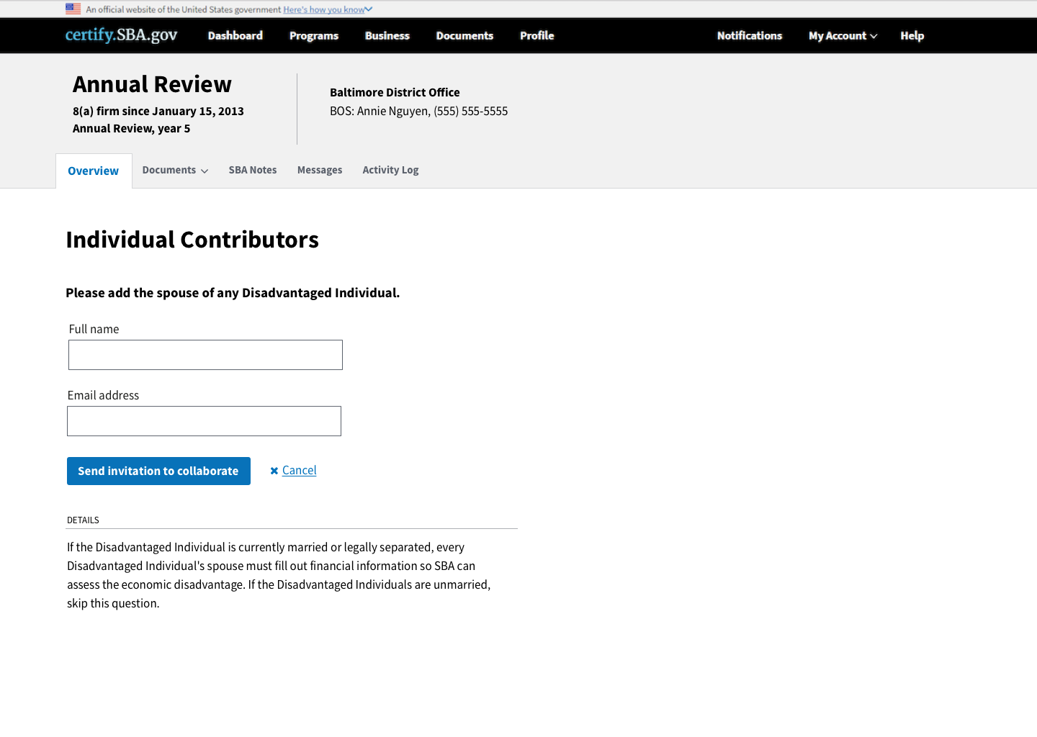
1st Time in Certify
All Contributors: DVDs, spouses, 10% owners, directors, management members, managing partners, and officers
The previous 3 years of personal federal tax returns
The previous 3 years of Balance Sheets and Profit & Loss Statements
All delinquent tax returns and delinquent SBA loans
Documentation that includes terms and restrictions of retirement accounts, such as traditional IRA, 401K, Roth IRA, Self Employed Pension Plan, Thrift Savings Plan, etc.

Slide 8
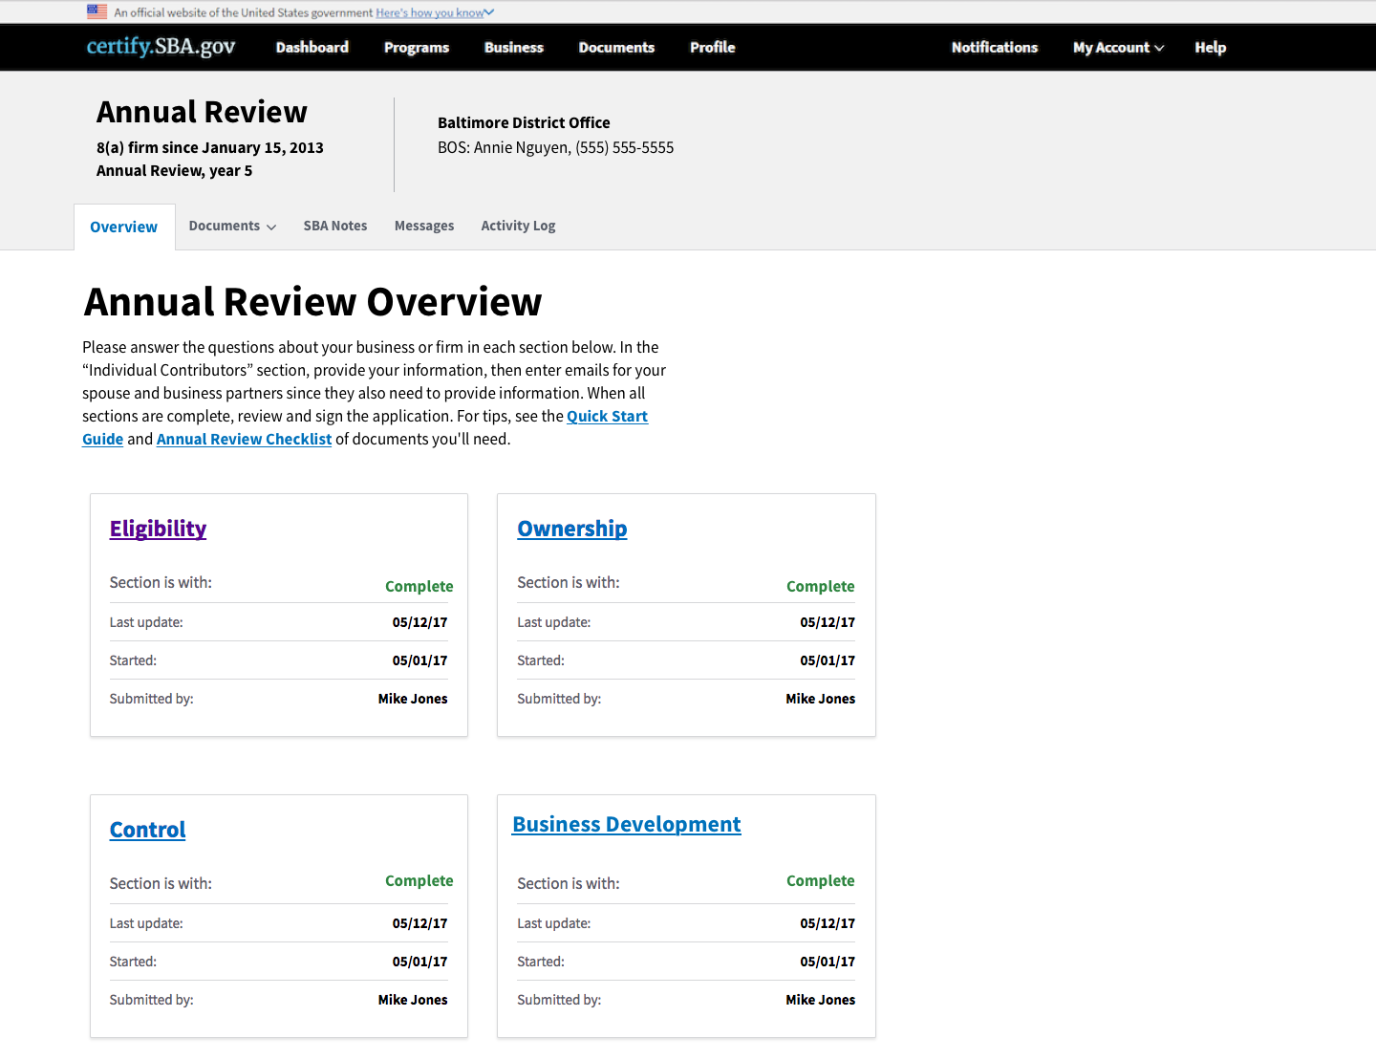

Slide 9
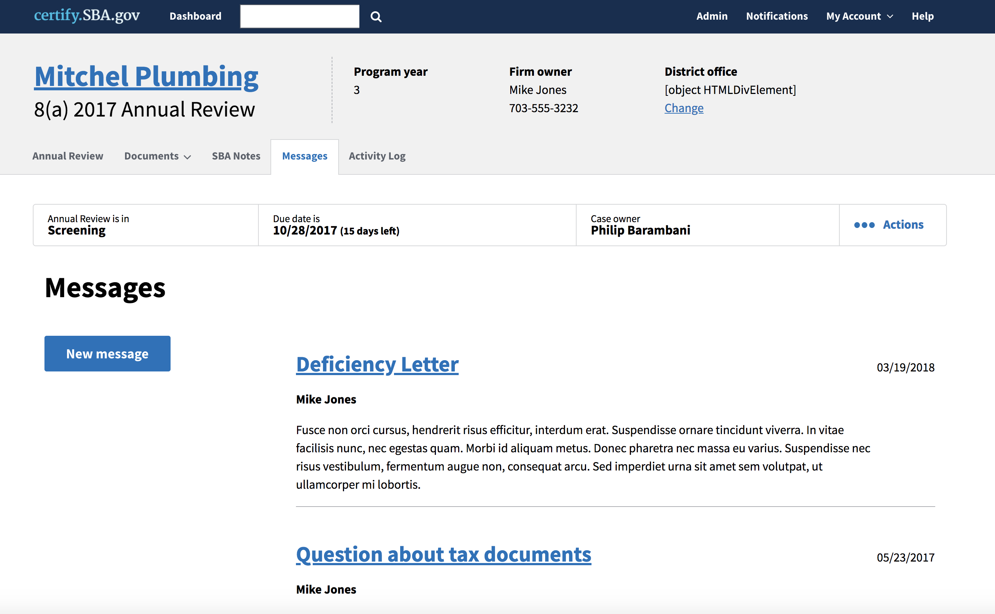
Deficiency Letter
Look in Messages
Respond within Questionnaires
Message SBA with your changes

Slide 10
By The Numbers

Slide 11
15
Number of days
To Check the Annual Review for Completeness (screening)

Slide 12
10
Number of days for
Firms to Respond to a Deficiency Letter during Screening

Slide 13
30
Number of days
To Make a Recommendation (SBA Processing)

