Slide 1
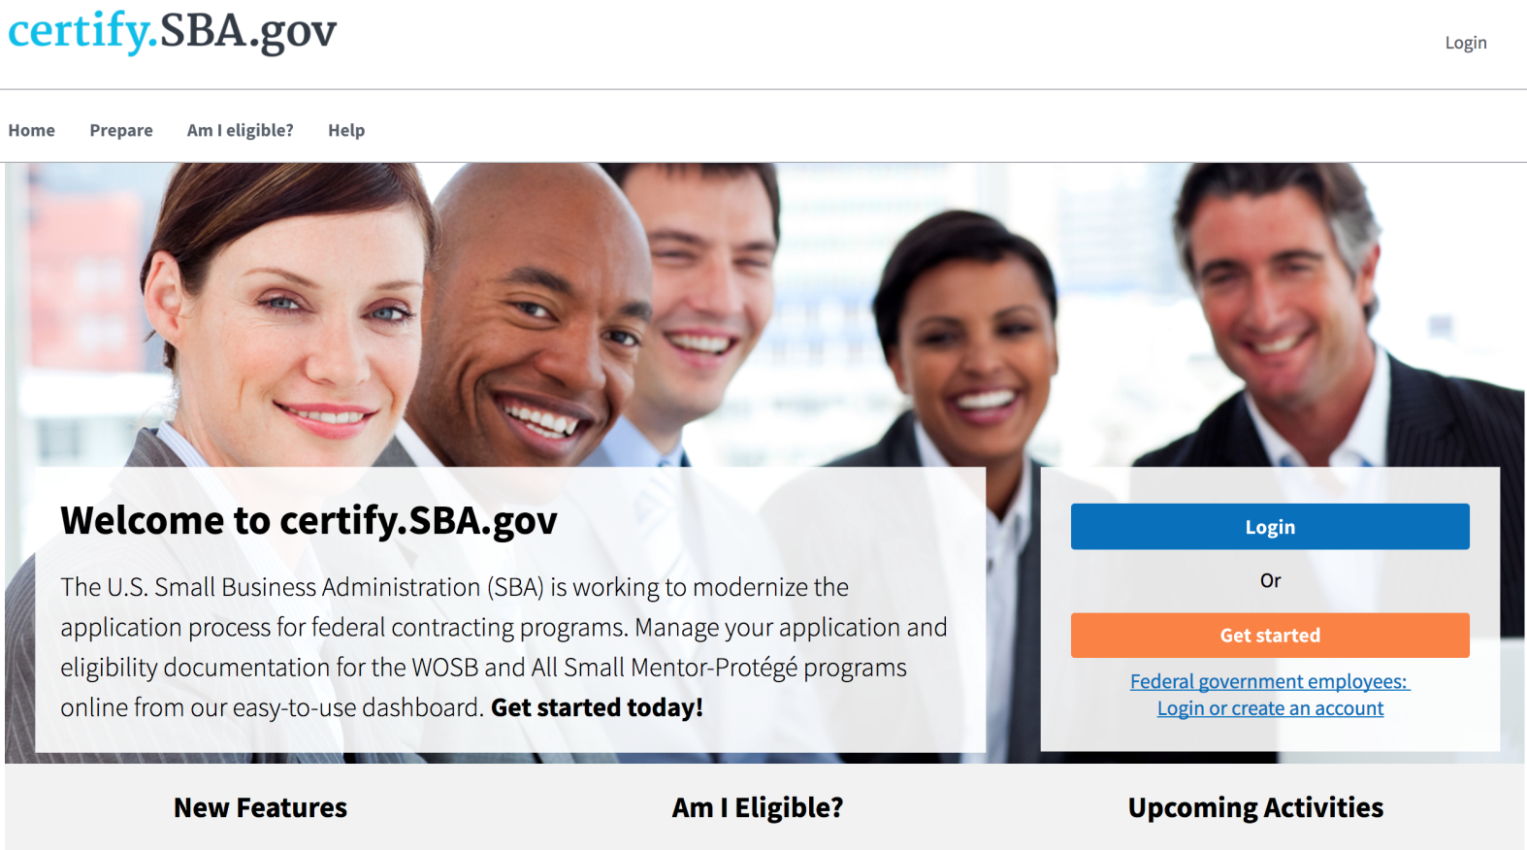
Firm Overview of 8(a) Annual Review in certify.SBA.gov
Presentation Created November 2017

Slide 2
Beginning January 2018, 8(a) firms will submit Annual Reviews in certify.SBA.gov.
This PowerPoint demonstrates how firms will submit their 8(a) annual reviews.

Slide 3
Our mission
To create a one-stop shop for small business to apply for SBA Small Business Programs.
To help SBA build an effective, efficient, and accountable case management system.

Slide 4
Before Certify
Paper Applications & Burdensome Processes
Small businesses downloaded forms, printed all required supporting documents, and mailed reams of paper to SBA simply to apply to the 8(a) program.
SBA mailed files between district offices to share information required to manage small business accounts. This adds up to hundreds of thousands of dollars in costs annually.

Slide 5
After Certify
Reuse Docs
Online Questionnaires
Eliminate redundancy by storing documents in one location and reusing them for future needs.
Firms now have the ability to complete online questionnaires rather than fill out lengthy and sometimes repetitive forms.
Transparency – Status Updates
Direct Messaging
Firms will be able to check their application dashboard for the most up-to-date information about their applications. This minimizes the need to call or email the SBA for information about where their annual review is in the process.
Firms will be able to respond to SBA requests via an internal messaging system. This ensures that personal information is safe and responses are not sent to spam or junk filters.

Slide 6
Firm View of Certify Features

Slide 7
Annual Review Overview
Firms will be able to see all aspects of their annual review on one page:
Annual Review Sections
Document Library
Messages Replace Email with SBA
Notifications of Tasks
People Involved in a Firm Directly Provide Info

Slide 8
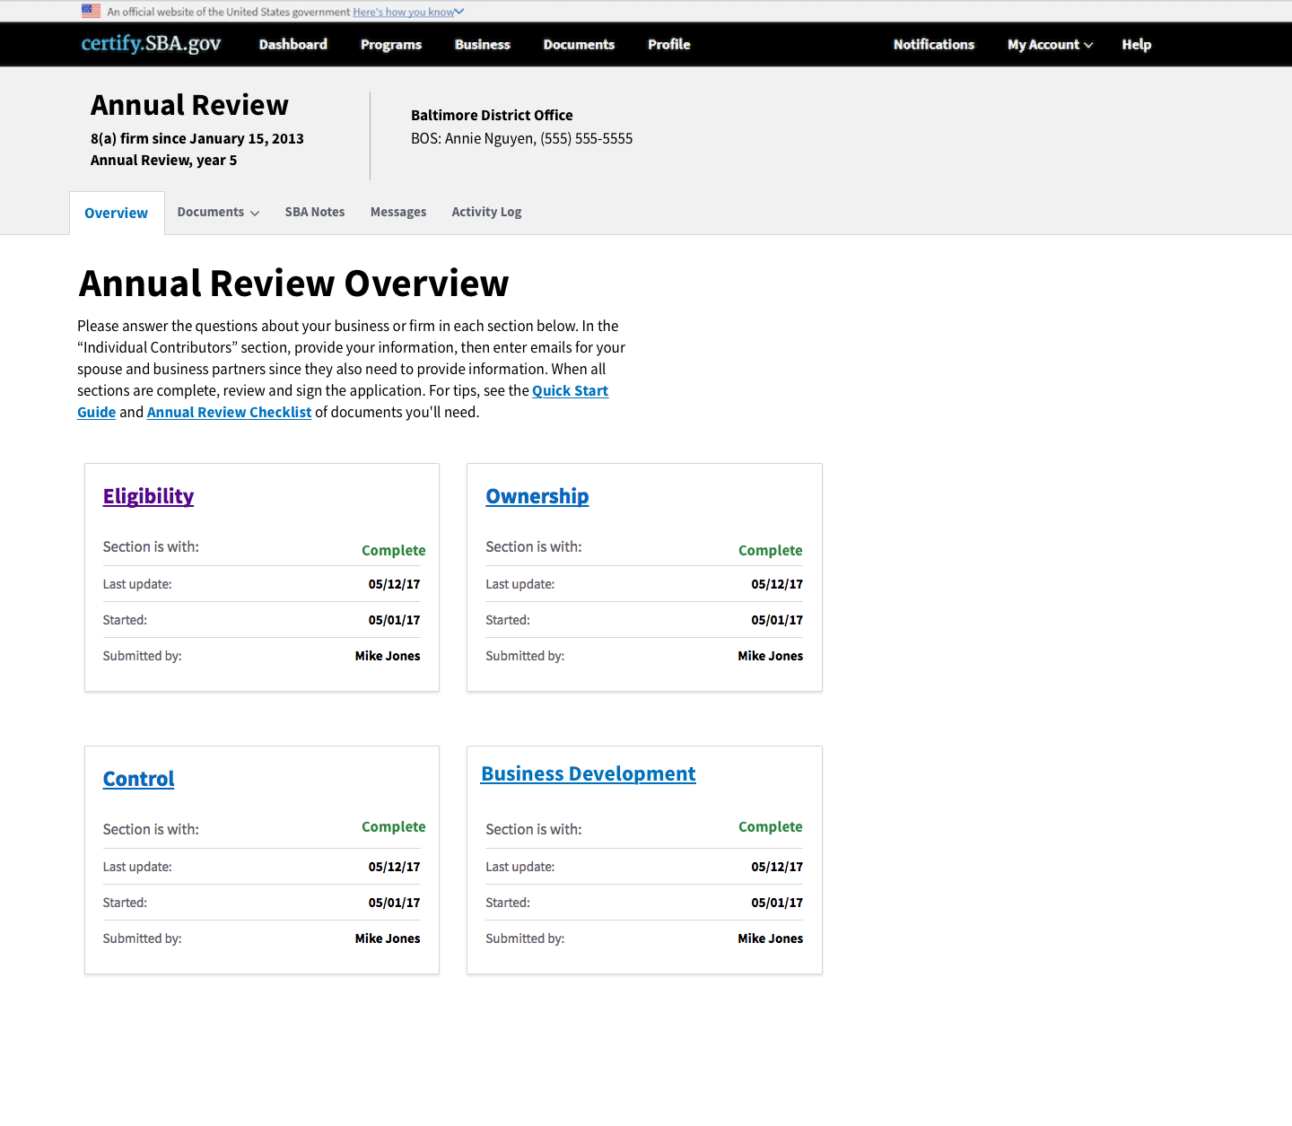

Slide 9
Meet the new Online Questionnaire
Most PDF/paper forms have been converted into online questionnaires to make it easier for firms to answer questions relevant to them.
Firms will answer each questionnaire in order until they’re done with all five sections.

Slide 10
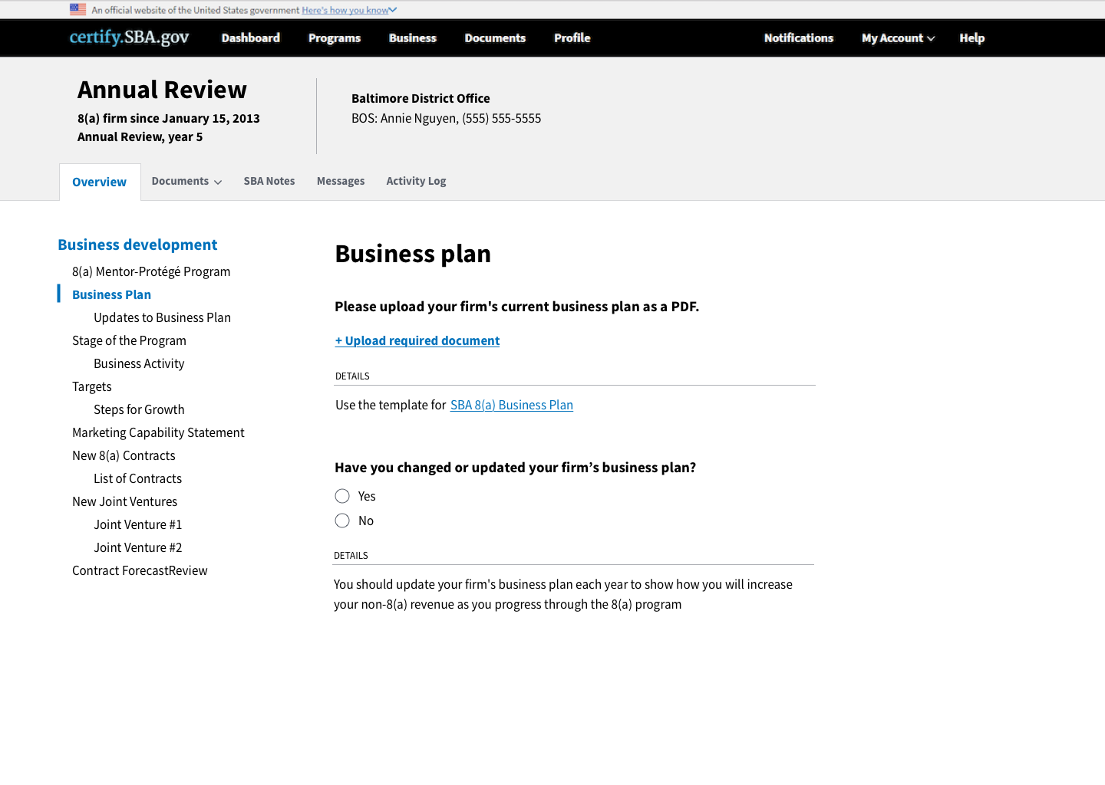

Slide 11
Document Library
Firms will upload documents as answers to questions but they will all be saved in their document library.
This means they will be saved and the firm can reuse them in future years.

Slide 12
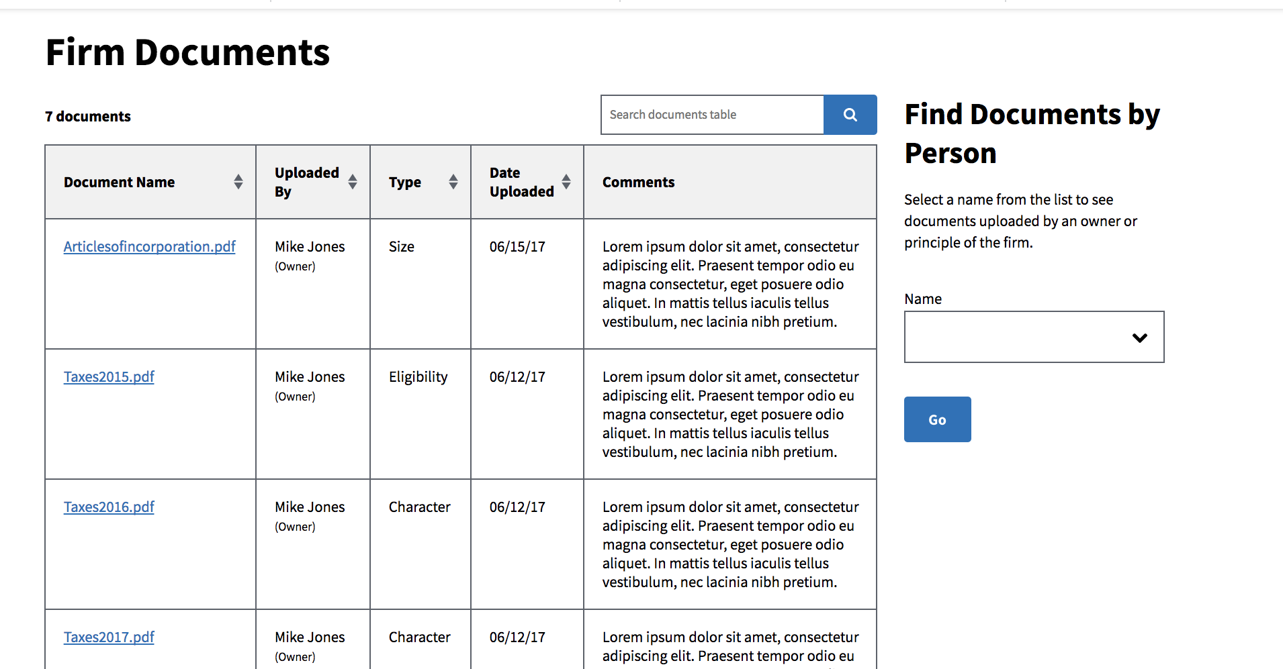
View the Document Library

Slide 13
Messaging within Certify
All correspondence between firms and SBA should happen within Certify. Firms should no longer use emails to submit information or data.
Sending messages within Certify is secure and a quick way to be in touch with SBA.

Slide 14
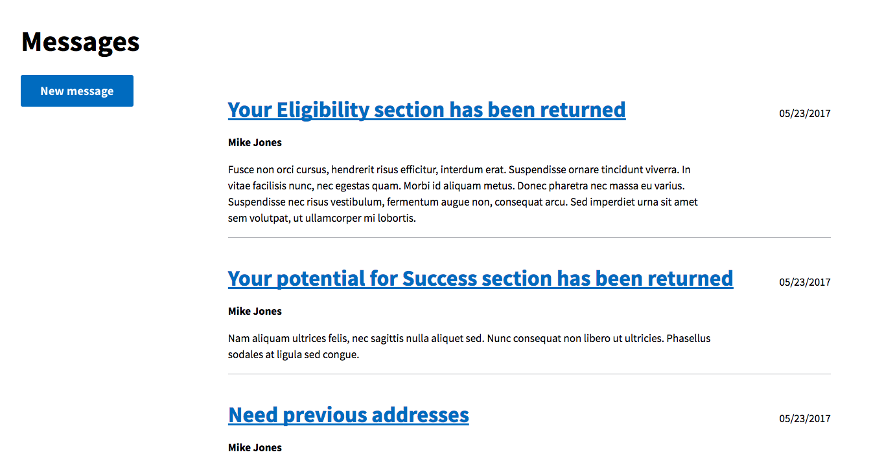
Messaging Replaces Email
Status Update Request
Your Business Development section has been returned
Need business plan

Slide 15
Contributor Access
Firms can now provide access to all people involved in their annual review.
The firm owner will be notified of which sections of the annual review still need to be completed.
8(a) firms that were approved in BDMIS, will need to complete additional questions in Certify in order to establish their profile in the system.

Slide 16
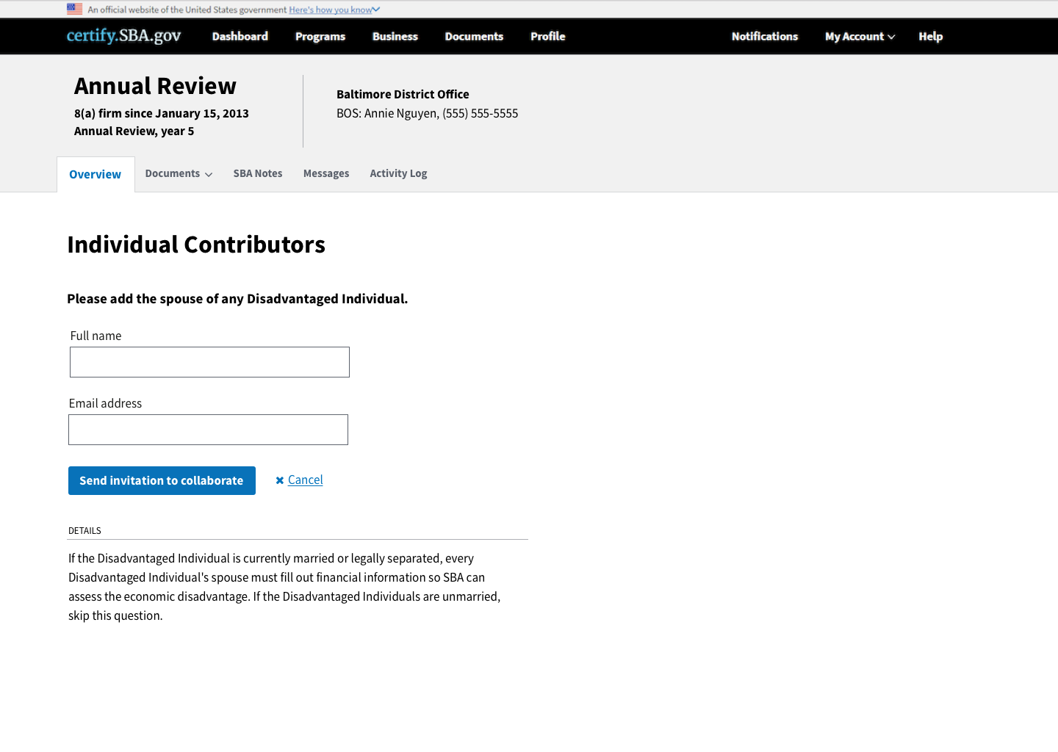

Slide 17
Firm Dashboard
Firm’s Dashboard of all Certifications:
The status of program applications and renewal deadlines
View all firm’s SBA certifications, not just 8(a).

Slide 18
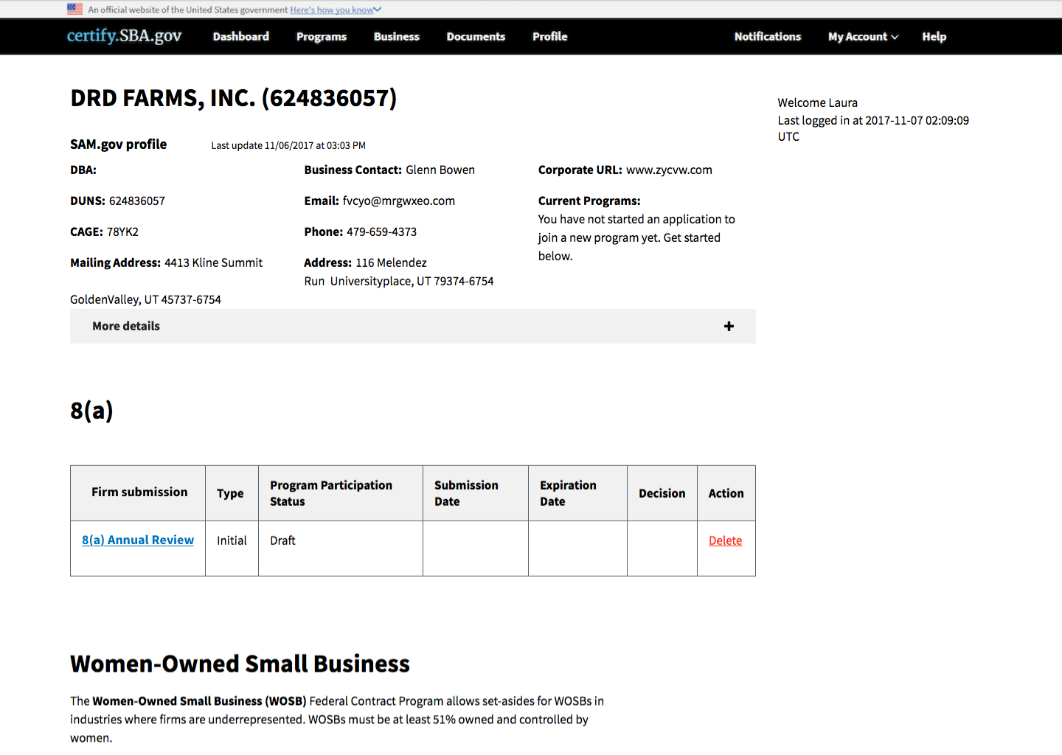

Slide 19
Completing Your Annual Review in Certify

Slide 20
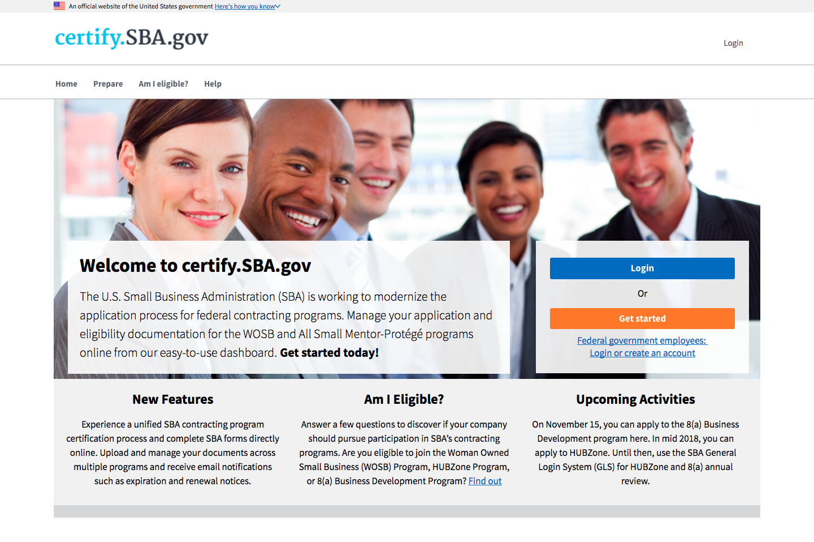
Firms must select “Get started” to kick off the registration process. Firms will then link their account to their SAM profile through their DUNS, MPIN, and TIN numbers.

Slide 21
On their dashboard, firms will select
“8(a) Annual Review” to start their annual review

Slide 22
Forms have been recreated as questionnaires. Firms will be walked through how to complete each section.

Slide 23
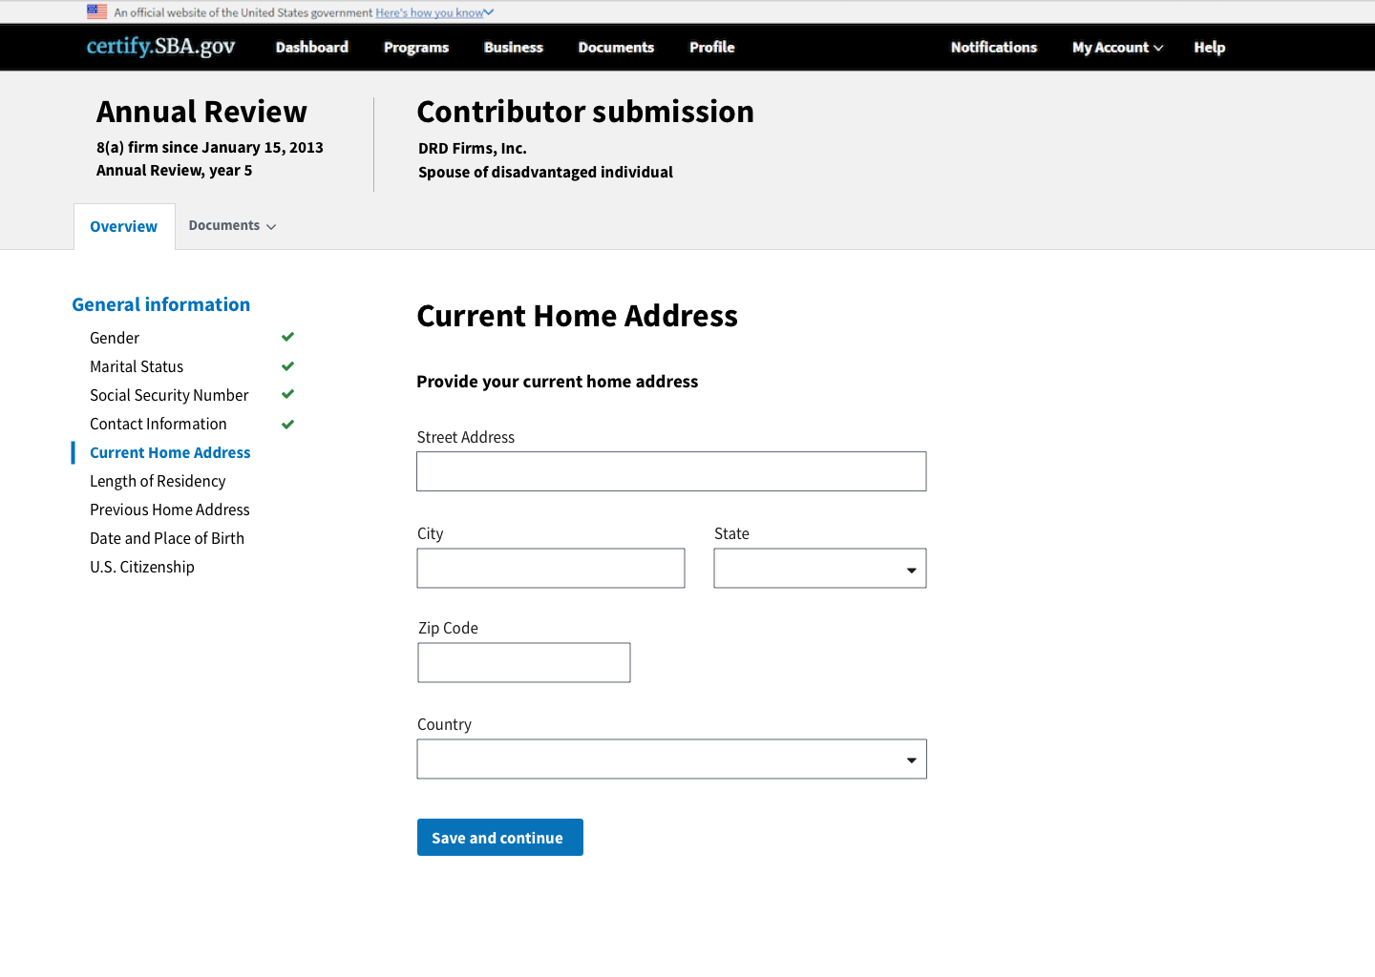
Partial firm owners and spouses of disadvantaged individuals will directly input their information.

Slide 24
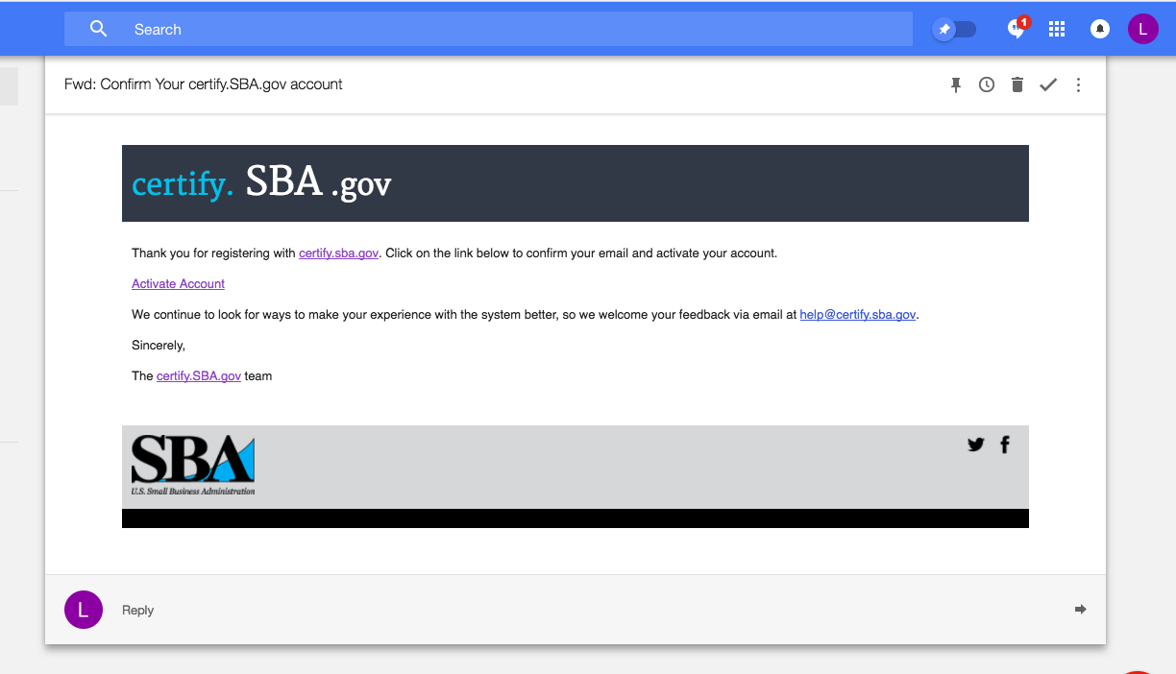
After submission, the firm owner should watch for emails from Certify with status updates and asking for additional details.

Slide 25
Nov. 2017
8(a) Initial Application

Slide 26
Jan. 2018
8(a) Annual Review

Slide 27
Training Sessions
Training Session | Training Date(s) | Primary Audience | Optional Audience
An Overview of 8(a) Annual Review in Certify for District Offices and Partners | Tuesday, 11/21 @ 2PM-3PM EST Tuesday, 11/28 @ 2PM-3PM EST (alternate dates) | Resource Partners & OFO | GCBD
An In-Depth Walkthrough of 8(a) Annual Review in Certify for District Offices and Partners | Tuesday, 12/12 @ 2PM-3PM EST Wednesday, 12/13 @ 2PM-3PM EST | Resource Partners & OFO | GCBD
Existing 8(a) Firm Walkthrough of Annual Update in Certify | Wednesday, 12/13 @ 11AM-12PM EST Thursday, 12/14 @ 2PM-3PM EST | Current 8(a) firms | Resource Partners, OFO, GCBD

Slide 28
Questions & Feedback
?
Questions?
Send us your feedback:
https://certify.ideas.aha.io/ideas

